Slide 1

Reverse Engineering - Ghidra
Carsten Hofsommer | Jean-Louis Klein
Notes:
<number>

Slide 2
Workshop plan
Introductory presentation
Reverse Engineering
Guided work with Ghidra
Do it yourself
Analyze
Crack
Run
Notes:
<number>

Slide 3
Content
Reverse Engineering
And how does it work?
Usage (legal or not?)
Compiling and decompiling
NSA (National Security Agency)
Ghidra
Short introduction into the IDE
Notes:
<number>

Slide 4
Reverse Engineering/Backwards Engineering
Engineer but backwards
From finished product to lose materials
Compile =/= Decompile
Why?
Crack to remove copy protection
Your favourite video games
Possible evidence in criminal affairs
Find vulnerabilites in an OS
Security loopholes (0Day Exploits, Remote access of your OS, etc.)
Notes:
<number>

Slide 5
Compiling
Compilers are complex, this explanation is highly simplified.
1. Lexing (breaking up the text into tokens)
2. Parsing (converting the tokens into parse tree)
3. Optimization (optimise the parse tree with actions as removing unused variables or evaluate constant expressions)
4. Translation (converting the parse tree into assembly code)
5. Run the code (the assembly code is translated into machine code)
(source: https://softwareengineering.stackexchange.com)

Slide 6
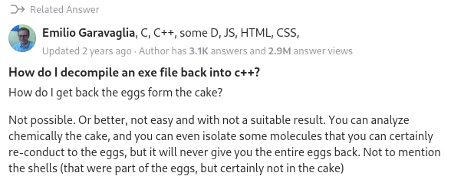
Decompiling
Getting the file back from an executable is impossible. (see picture)
A decompiler reads the assembly code (in step four of our decompiling) and knows what action will happen.

Slide 7
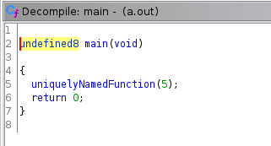
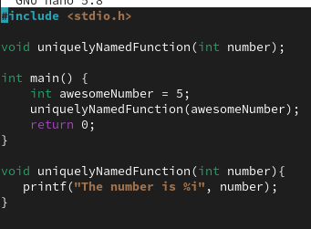
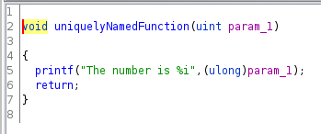
Decompiling
Decompiled
Original:

Slide 8
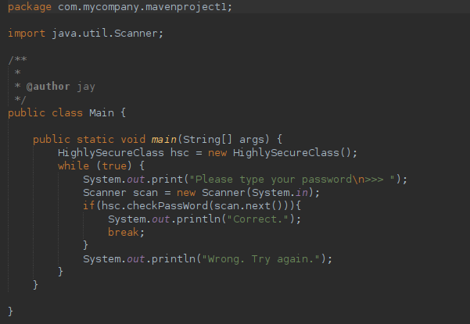
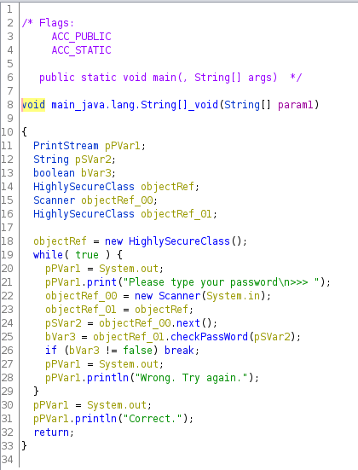
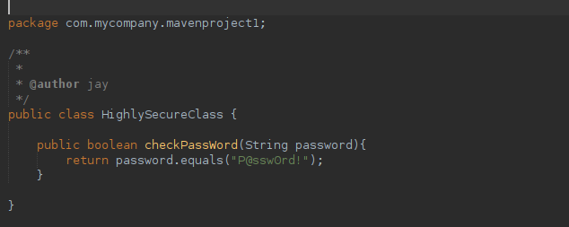
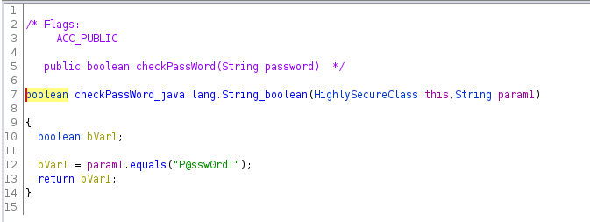

Slide 9

NSA
National Security Agency
Founded in 1952
Part of US military
Main task: digital surveillance
(Think of things like internet, radio waves, phone communication, etc.)
Source: Wikipedia

Slide 10
NSA
The NSA also creates software (to support their main task).
Many projects are secret, but many are also FOSS (Free and Open Source Software).
Besides raising awareness of cyber security (for companies and individuals), the NSA makes software FOSS to cut costs.
Their FOSS-project can be found on:
https://code.nsa.gov/
https://github.com/NationalSecurityAgency
Notes:
<number>

Slide 11




NSA
Some of their FOSS projects:

Slide 12
Ghidra
Released as a free, open source software on 5th of March 2019
Improve cybersecurity tools
Build a community
Build on Java
Runs in a VM
GhidraDoc: https://ghidra.re/ghidra_docs/api/index.html
Active Github page
Other tools: IDA, Radare, Binary Ninja
Source: https://ghidra-sre.org/
Notes:
<number>

Slide 13
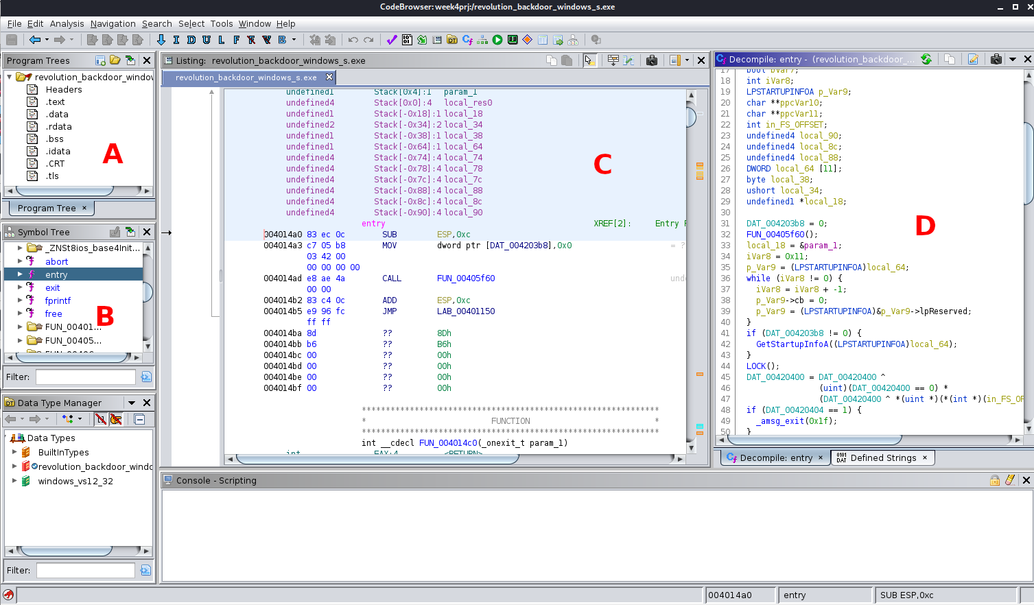
How does Ghidra work?
Decompiling files
Solo or Team option
Creates/Shows:
Program Tree
Symbol Tree
Dummy variable names
Virtual addresses (memory)
Java ByteCode Instructions
High-level Code representation(C, C#, Java, …)
Source: https://class.malware.re/2020/02/05/ghidra-intro.html
Notes:
<number>

Slide 14
Tackle viruses / analyze encryption schemas
Analyze all kinds of viruses (e.g. RAT – File (Remote Access Trojan, WannaCry, etc.)
RAT – File: Find out what it is doing. (Most commonly it tries to disable User Account Control (UAC) by modifying values in the registry)
WannaCry: Find the kill switch. (The program tried to reach a specific domain, if the domain is unassigned the program kept going, if assigned the program stopped immediately)
Encryption Schemas: Could be: database encryption, Plaintext -> Cypertext with a session key, etc.
All you need is a file that contains the important algorithm (Binaries, Executables, …)
Source: https://blogs.blackberry.com/en/2019/07/an-introduction-to-code-analysis-with-ghidra
Notes:
<number>

Slide 15
Additional Sources:
Java ByteCode Instructions: https://en.wikipedia.org/wiki/List_of_Java_bytecode_instructions
0Day Exploit: https://cybersecurity.osu.edu/cybersecurity-you/avoid-threats/what-zero-day-exploit
WannaCry: https://medium.com/@yogeshojha/reverse-engineering-wannacry-ransomware-using-ghidra-finding-the-killswitch-a212807e9354
RAT – File: https://www.howtogeek.com/410634/what-is-rat-malware-and-why-is-it-so-dangerous/

Slide 16
Practical part
Crackmes.one (https://crackmes.one/lasts/1)
Introduction to the Environment
Choose out of 5 programs to decompile
Notes:
<number>

Slide 17
How to install and use
Download at https://github.com/NationalSecurityAgency/ghidra/releases
Version 10.0.3 (Assets -> ghidra_10.0.3)
Extract zip file to your desired location
Download JDK 11 if necessary
Add it to your PATH
Support/launch.properties JAVA_HOME_OVERRIDE
Add complete path to jdk
„ghidraRun“ in Console

